Slide 1
Mini Project Data Analysis Analytics Dashboard Traffic Alerts in West Java using Waze Data
by Adrian Maulana Muhammad
https://github.com/adrn-mm/DSLS_Mini-Project-DA_Adrian-Maulana-Muhammad

Slide 2
Table of Contents
Dashboard Use Case
Dashboard Components
Summaries & Recommendations from Dashboard
References

Slide 3
Dashboard Use Case
I

Slide 4
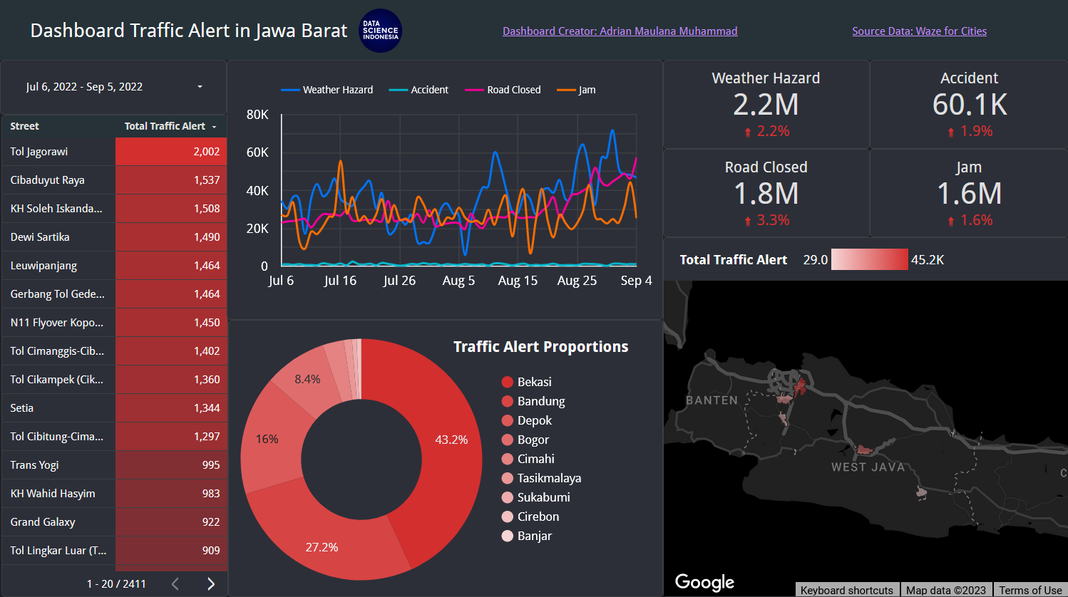
Dashboard Traffic Alert in West Java
This analytics dashboard provides a comprehensive overview of the distribution of traffic alerts in the city and street of West Java. It serves as a tool for the local government to effectively monitor and gain insightful analysis of their area's traffic conditions. With real-time updates and visual representation, this dashboard empowers officials to make informed decisions and take swift actions to alleviate congestion, enhance safety, and improve regional mobility.
https://lookerstudio.google.com/reporting/f232d16a-5034-4596-b94e-eabb5c0fdb70

Slide 5
Dashboard Components
II

Slide 6
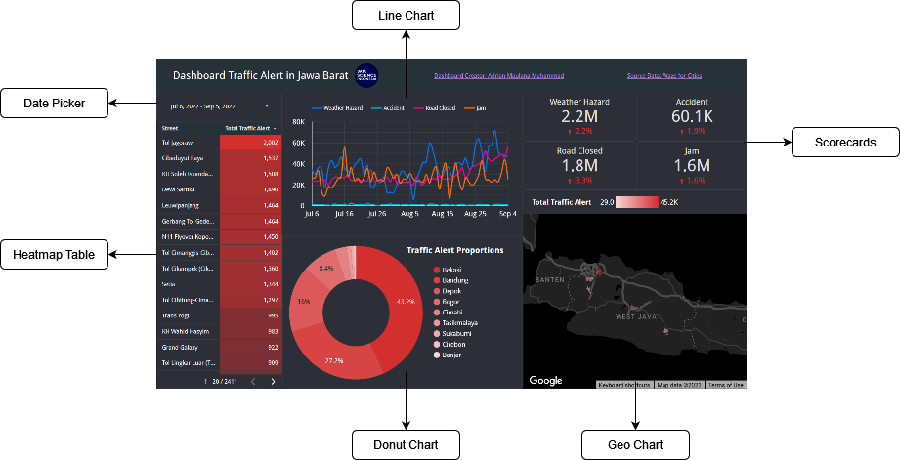
Overall Components

Slide 7
Components Reasoning
Component | Reasoning
Date Picker | This component can be used interactively by the user to determine time intervals on the data.
Heatmap Table | This component displays the total traffic alert records sequence for each street, starting from the highest value. The color red is chosen to indicate that an increase in value is undesirable, with brighter shades of red on the component indicating higher values.
Donut Chart | This component displays the proportion of traffic alert records for each city. The reason for the chosen color scheme is the same as the previous explanation.
Geo Chart | This component visualizes the previous proportions in a Geo Map format, allowing users to view the distribution based on the map's conditions.
Scorecards | This component is designed to show the status and progress of each metric.
Line Chart | This component is used to indicate the changes in values of each metric over time, with each metric having a different color to clearly depict the changes.

Slide 8
Summaries & Recommendations from Dashboard
III

Slide 9
Summaries & Recommendations
According to the analytics dashboard, it has been identified that the Jagorawi Toll Road has the highest number of total traffic alerts during the specified date range. This information can be used to investigate the causes of the high alert rate.
Based on the analytics dashboard, it has been determined that the city with the highest proportion of traffic alerts during the specified date range is Bekasi. This finding provides valuable insights into identifying the underlying causes of the high alert rate.
The analytics dashboard results have revealed that the top three status types of traffic alerts with the highest frequency during the specified date range are Weather Hazard, Road Closed, and Jam. In contrast, an Accident is the most minor reported status type of traffic alert. This information provides critical insights into the traffic issues frequently occurring in the area.

Slide 10
References
IV

Slide 11
https://medium.com/data-science-school/google-data-studio-in-10-minutes-step-by-step-guide-867a2bf920f1

Slide 12
Thank You!

